Slide 1
Build Visual AI Agents with Generative AI and NVIDIA NIM
NVIDIA Metropolis Webinar

Slide 2
Agenda
• | Visual AI Agents
• | Vision Language Models (VLMs)
• | NVIDIA NIM
• | Reference Workflows with NIM
• | Create Visual AI Agents with VIA Microservice
• | Build Edge AI Agents on NVIDIA Jetson
• | Get Started

Slide 3
GTC24-KEYNOTE-Metropolis-Video.mp4
No Audio

Slide 4
Metropolis-VIA-Siggraph-Montage.mp4
No Audio

Slide 5

Vision Language Models are Evolving at an Astonishing Pace
100+
Image & Video
Long video understanding / summarization
Tunable architectures
Small VLMs
Spatial understanding
Character recognition
Multi-lingual
Zero-shot capabilities
Number & Capabilities of
Vision / Multi-modal Models
Vision Transformer
2020
2021
2022
2023
2024

Slide 6
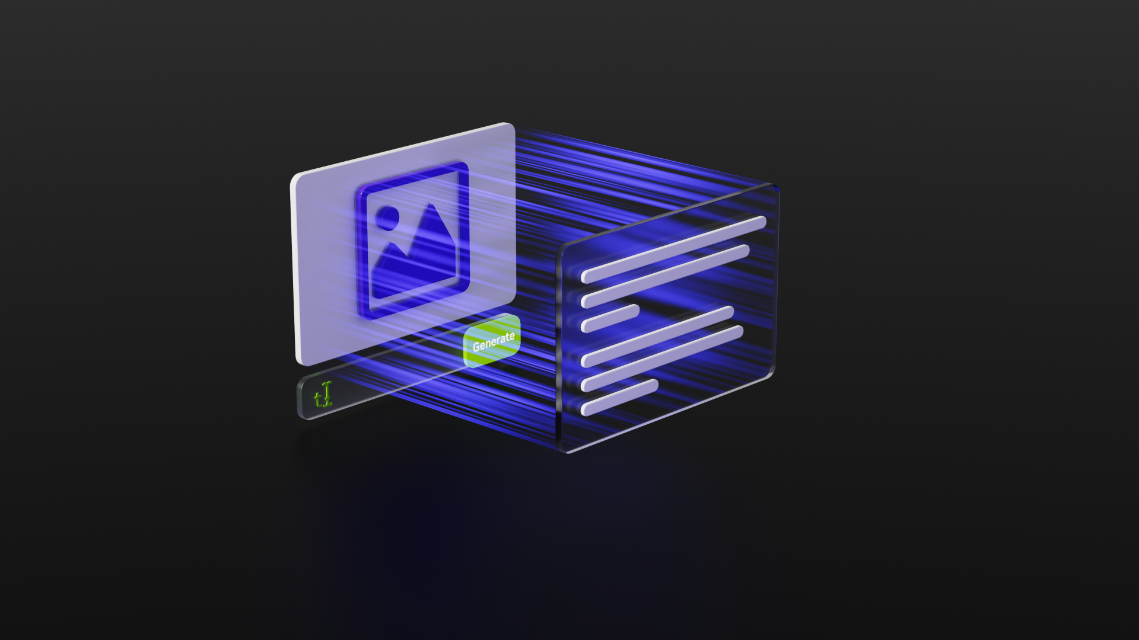
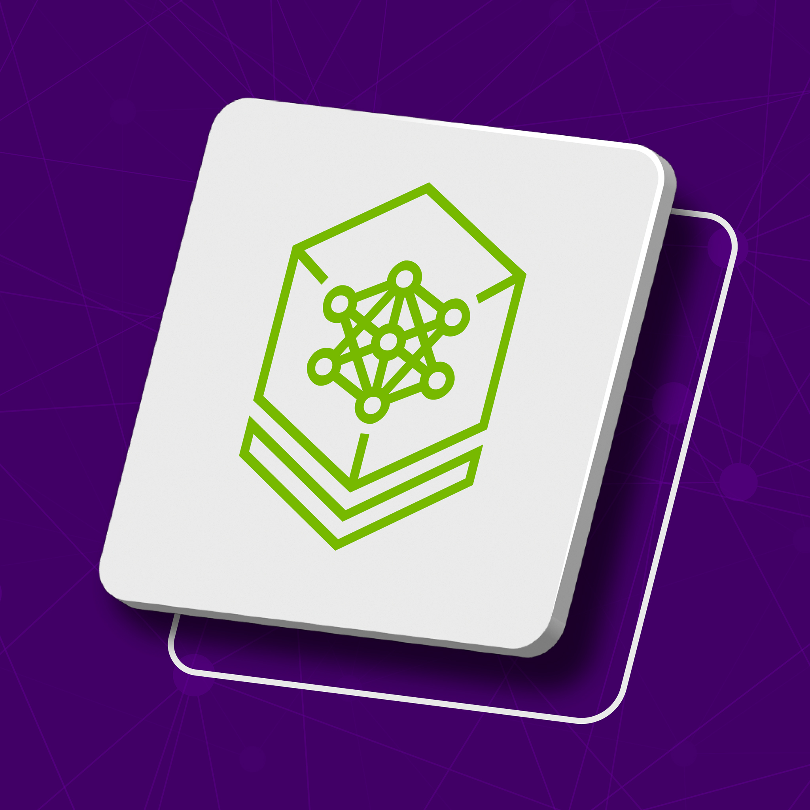
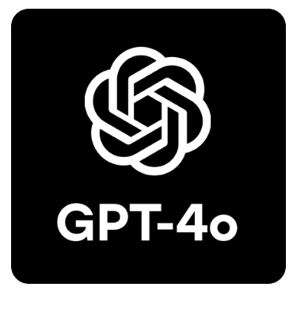
Vision Language Models are Evolving at an Astonishing Pace
100+
Number & Capabilities of
Vision / Multi-modal Models
• • •
NVIDIA VILA
3B-40B parameters
Microsoft Phi-3.5
4.2B parameters
OpenAI GPT-4o
>200B parameters
Available soon for commercial use
Good at video and spatial understanding
SOTA accuracy on several VLM benchmarks
Fast & Efficient
Multi-Image and Video input
Zero-Shot OCR, image captioning and Q&A
Flexible VLM - leads most VLM benchmark
Proprietary model
Vision Transformer
2020
2021
2022
2023
2024

Slide 7
NVIDIA VILA - Industrial Strength VLM
Better accuracy through fine-tuning of both Vision encoder & LLM
Optimized throughput / performance through quantization
For Commercial purposes, deployable edge to cloud
Source: https://arxiv.org/pdf/2312.07533.pdf
Notes:
Let us start with VILA - Visual Language Assistant is NVIDIA VLM that can do Image and multi-image question answering. The high level architecture of VILA contains a Vision encoder typically a ViT from CLIP model, which ensures vision embedding is already aligned with the text embedding. This is followed by a projector which is a simple linear layer. Finally, the visual tokens output from the linear layer are concatenated with the textual tokens from the input prompt and fed into the LLM to generate response. The key features of VILA is that they update LLM weights during the pretraining and Supervised Finetuning which prevents text output degradation and keeps the accuracy of LLM intact. They also use interleaved dataset in their pre-training and finet-tuning. Interleaved dataset contains text embedded with images inbetween. Consequently, the model is equipped to handle text and image tokens together in the encoder. This enables in-context learning and multiple image question-answering which we will see in the next slide.
VILA outperforms state-of-the-art models LLaVA-1.5, Fuyu-8B.
We quantized VILA using 4bit AWQ which runs at 6ms/token for VILA-7B on a single 4090 GPU.

Slide 8

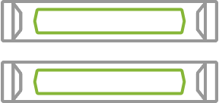

NVIDIA Metropolis Stack for Building Visual Agents
Reference Workflows to build Visual AI Agents
Recipes and sample apps to make it easy to evaluate Gen AI & VLMs and speed up the development of AI agents into your business apps.
NIM Sample Apps
Agent with VIA Microservice
Edge Agent with Jetson Platform Services
NVIDIA NIM /
CV MODELS
FINE-TUNING
METROPOLIS MICROSERVICES
Optimized microservices for flexible and easy cloud-native development with simple API calls.
Deploy Visual AI Agents from edge to cloud.
Jetson
Servers
Cloud
Powerful and Customizable VLMs and specialized CV foundation models.
Finetuning models through NeMo and TAO.
Notes:
There is roughly 3 aspects of our stack we’re going to cover. NIMs. 2-Microservices. And 3 - the Ref Workflows/Apps that show how to pull NIMs and microservices together to build apps. To build Ai Agents.
We’ll start with NIMs. We’ll show some sample apps to explore/experiment with NIMs. Then we’ll share with new microservices – and show the reference workflows and sample apps for them

Slide 9
NVIDIA NIM

Slide 10

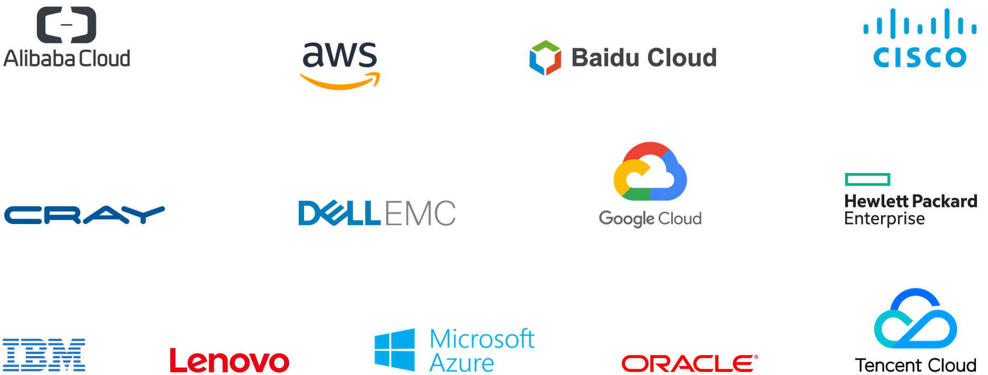





NVIDIA NIM Microservices
NVIDIA NIM
Deploy anywhere and maintain control of generative AI applications and data
Prebuilt container and Helm chart
Simplified development of AI application that can run in enterprise environments
Industry standard APIs
Day 0 support for all generative AI models providing choice across the ecosystem
Support for custom models
Improved TCO with best latency and throughput running on accelerated infrastructure
Domain specific code
Best accuracy for enterprise by enabling tuning with proprietary data sources
Optimized inference engines
Enterprise software with feature branches, validation and support
DGX &
DGX Cloud
Notes:
Starting on the left, our platform is built on a foundation of prebuilt containers and Helm charts, ensuring that our infrastructure is robust, tested, and validated across various environments including Microsoft Azure, AWS, and Google Cloud.
Moving upwards, we've adopted industry-standard APIs in conjunction with NVIDIA Cloud standards to facilitate seamless integration and interoperability across systems.
For those working in specialized fields, we provide domain-specific code for a variety of NIM domain categories, including Large Language Models (LLMs), Vision Language Models (VLMS), video processing, healthcare, and more. This ensures that you have the tools necessary for your specific use case.
Our inference engines are optimized for each model and hardware SKU, delivering unparalleled performance no matter the application.
We also recognize the importance of customization. That’s why we offer support for custom models built by users for targeted use cases, ensuring that you can adapt our technology to your unique requirements.
All of this is built on an NVIDIA AI Enterprise approved base container, guaranteeing a reliable and secure foundation for your AI applications.
Shifting focus to the right side of the slide, our NVIDIA NIM platform offers the flexibility to deploy your applications anywhere while maintaining control of your generative AI applications and data.
We've simplified the development of AI applications to allow for smooth operation in enterprise environments, which means quicker integration and deployment for your teams.
We are proud to offer Day 0 support for all generative AI models, providing a wide range of choices across the ecosystem, and ensuring that you can leverage the latest advancements in AI from the get-go.
Cost efficiency is key, and we've worked hard to improve Total Cost of Ownership (TCO) with the best latency and throughput, running on accelerated infrastructure.
Accuracy is paramount, especially in enterprise settings. Our platform enables best accuracy by allowing tuning with proprietary data sources, ensuring that your models are as effective and precise as possible.
Lastly, we offer enterprise software with feature branches, validation, and support, ensuring that you have the backing you need to successfully deploy and maintain your AI applications.
Supported by industry giants like Oracle, Dell Technologies, Hewlett Packard Enterprise, Lenovo, and Supermicro, you can trust that our platform is recognized for its capability and reliability.
In conclusion, the NVIDIA NIM platform is your comprehensive solution for deploying generative AI applications at scale, with the speed, flexibility, and efficiency your enterprise needs.

Slide 11

NVIDIA NIM for Vision Tasks
https://build.nvidia.com
VISION LANGUAGE MODEL (VLM) NIM
CV / SPECIALIST NIM
New
NEVA
Phi-3-
Vision
Paligemma
Kosmos-2
Fuyu 8B
Visual
ChangeNet
Retail Objects
OCD /
OCR
NV-Dino
v2
New
New
New
New
Coming Soon
Coming Soon
Coming Soon
Florence 2
7B
VILA 1.5 (Image)
VILA 1.5 (Video)
Phi-3.5-
Vision
NV-CLIP
Grounding Dino
SAM 2
Multimodal models that reason against image/video and perform descriptive tasks - including detailed image captioning, visual Q&A and video summarization
Building blocks for specific visual perceptive tasks like semantic segmentation, zero-shot detection and classification
Notes:
As of Siggraph next week – we will have 14 NIMs for Vision Tasks.a Very exciting collection.
Split into VLMs – powerful models that can reason and provide descriptions of imagery/video.
And on right Specialist NIMs – specific, building block CV capabilities. For more customized apps
All are preview right now. With 4 new ones going live as preview for Siggraph next week.
Chintan – want to provide any color on hich ones are most ex

Slide 12
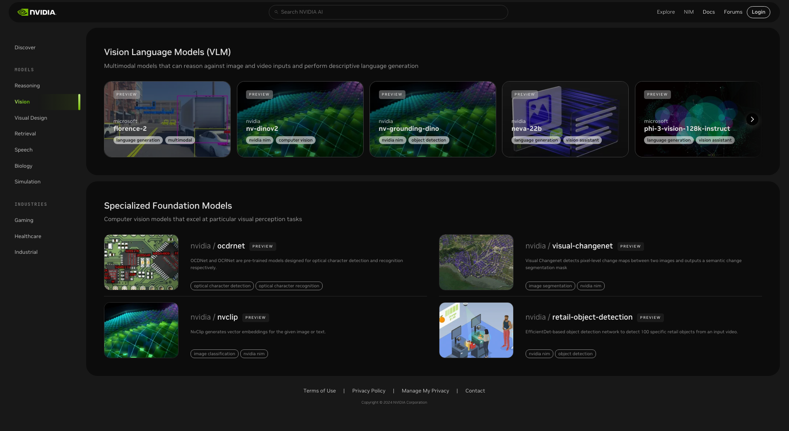
build.nvidia.com
Notes:
And these NIMs are available and hosted on build.nvidia.com
The NIMs in preview now can be experimented with. Directly on the page or through API calls

Slide 13
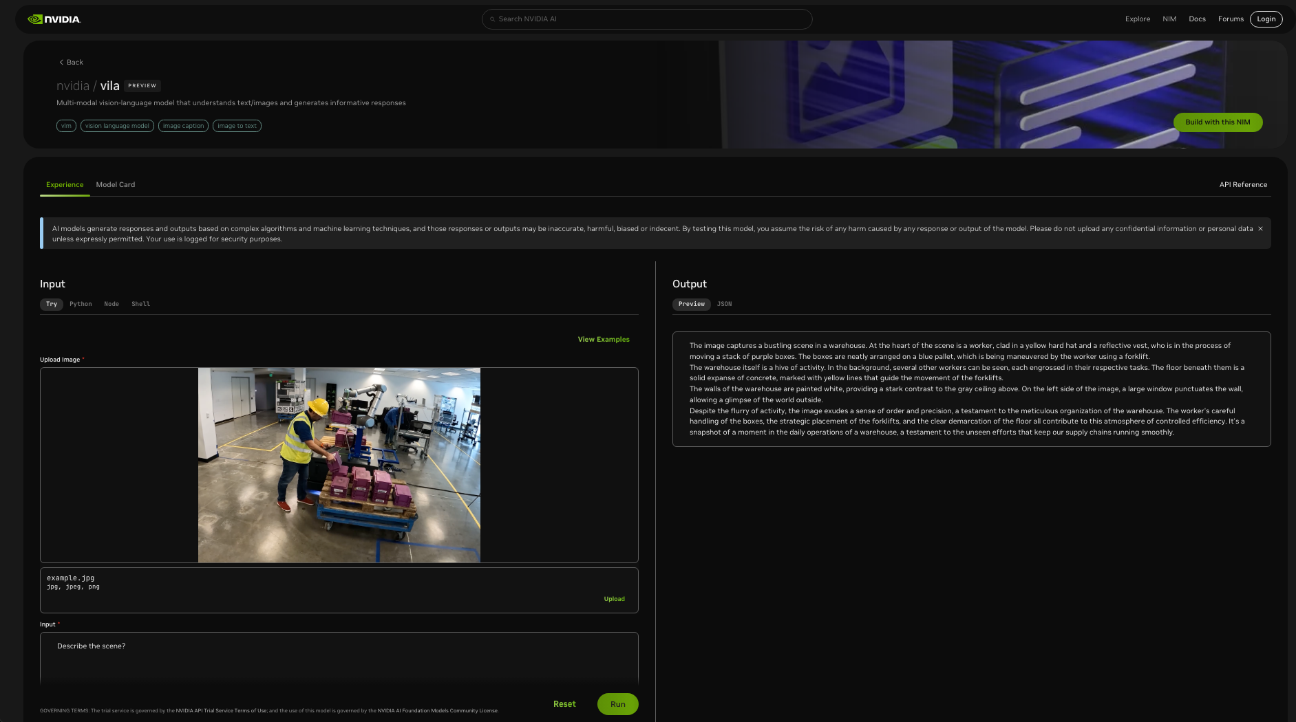

Slide 14
Reference Workflows with
NVIDIA NIM

Slide 15
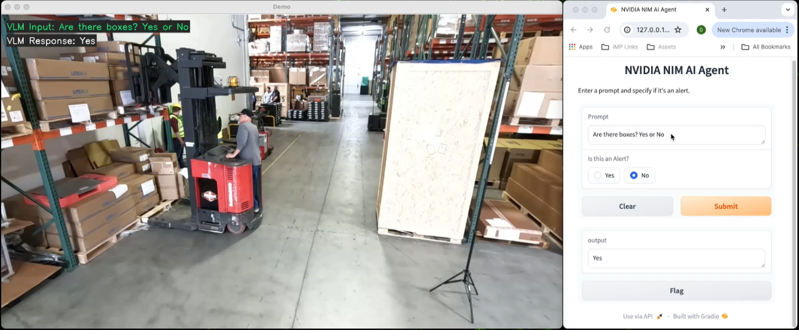
Evaluate and Experiment with Vision Language Models (VLM)
From simple Jupyter Notebooks to Nearly Production-ready Sample apps
Try here: https://github.com/NVIDIA/metropolis-nim-workflows

Slide 16
VLM_NIM_video.mov
No Audio

Slide 17
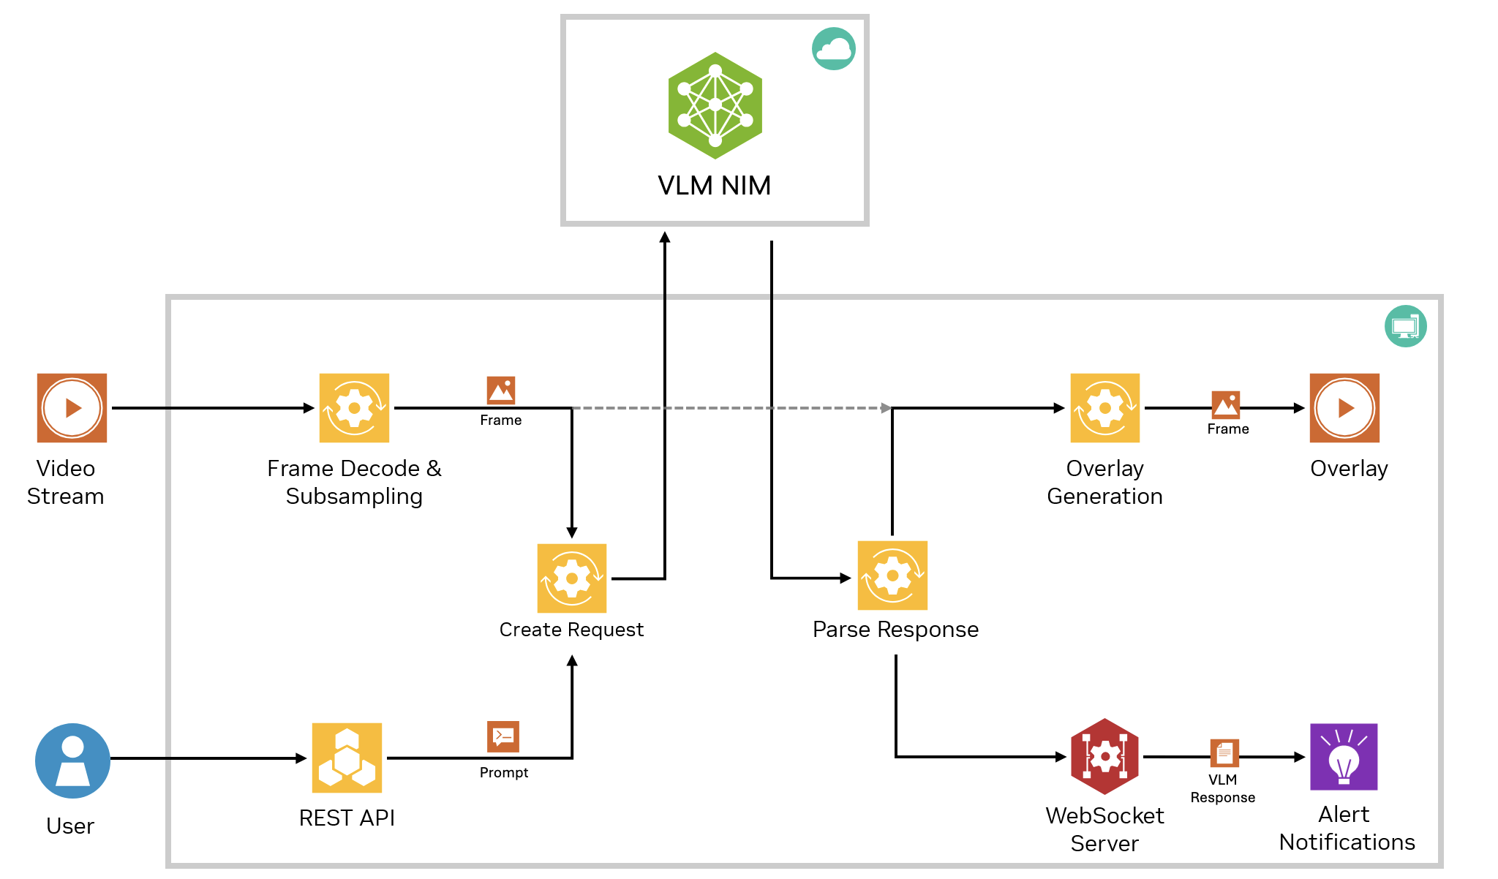
Metropolis Reference Workflows & Sample Apps
Recipes to Build a Wide Range of AI Agents
Try here: https://github.com/NVIDIA/metropolis-nim-workflows

Slide 18
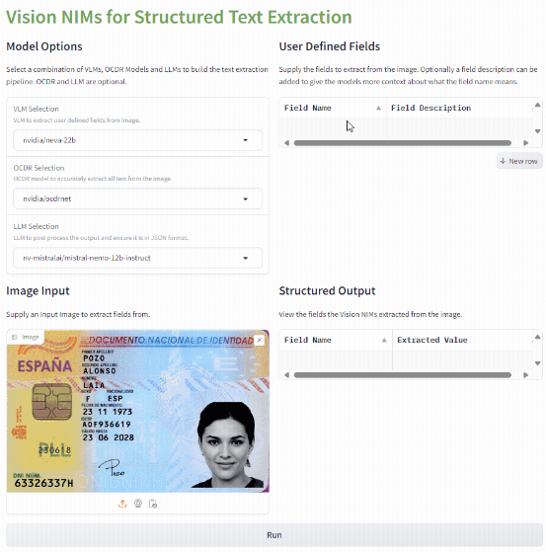
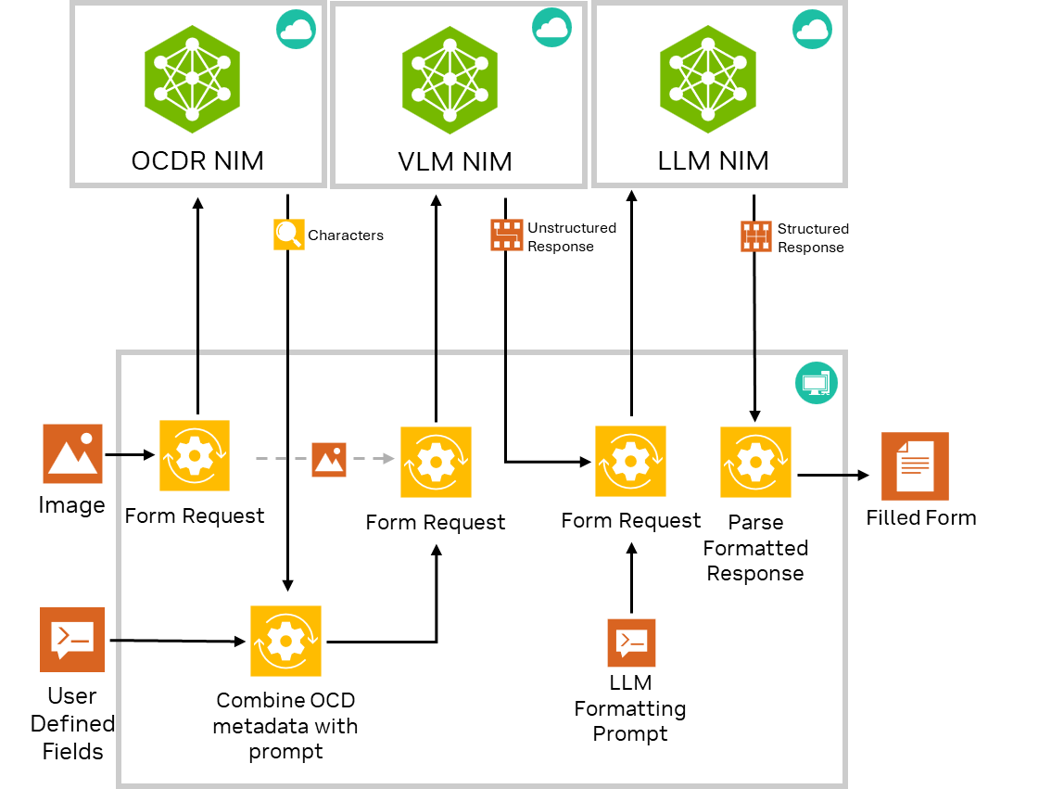
Structured Text Extraction Reference Workflow
Robust Structured Text Extraction on any Image
Try here: https://github.com/NVIDIA/metropolis-nim-workflows

Slide 19
text_extraction_demo.mp4
No Audio

Slide 20
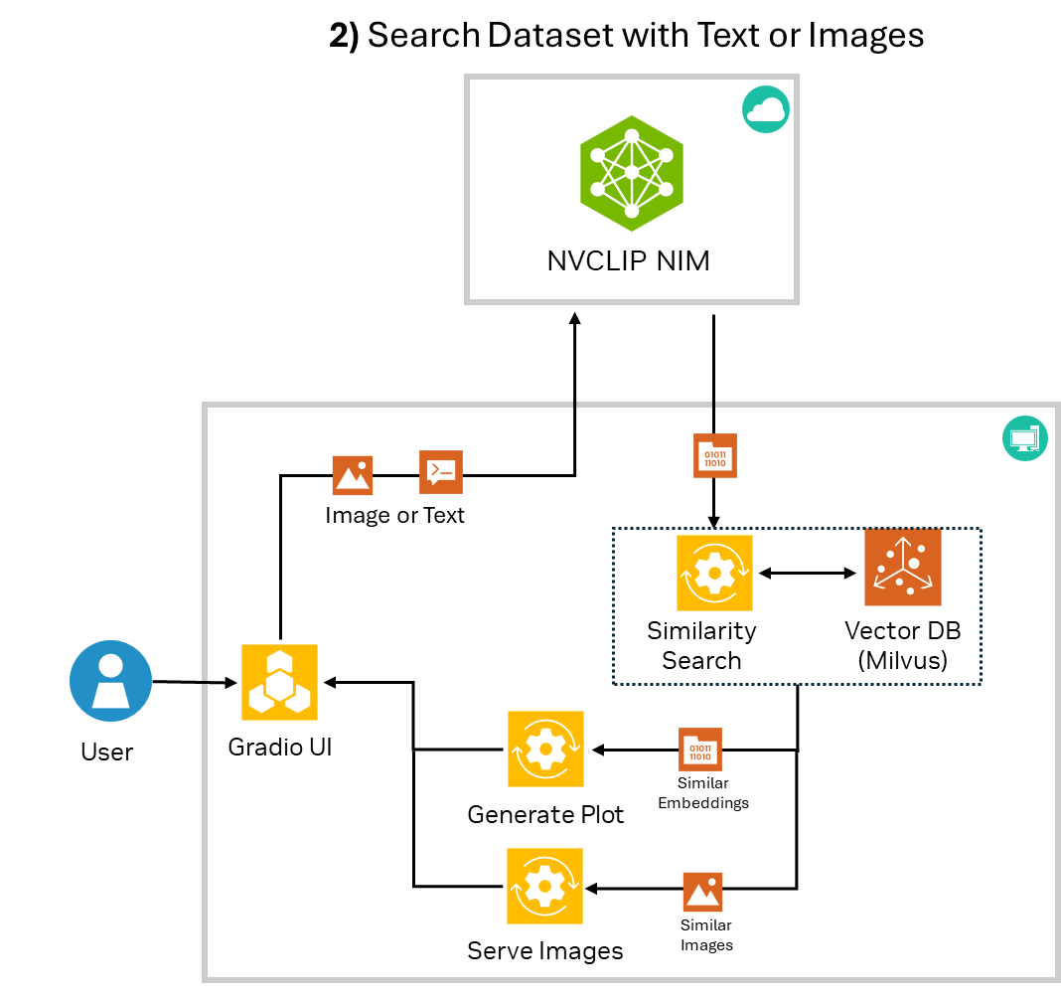
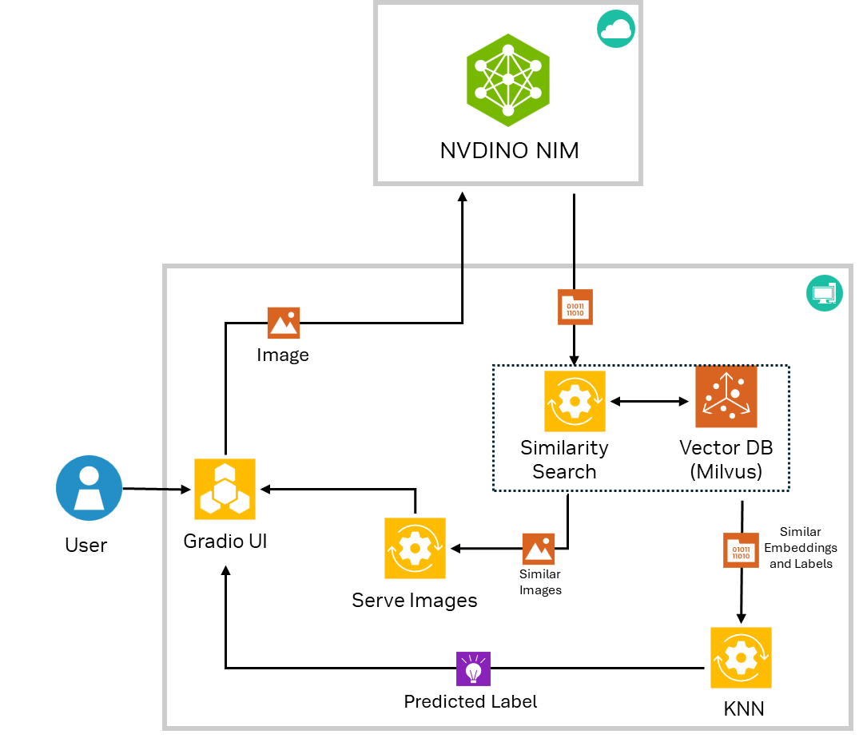
Reference Workflows with Foundation Models
Semantic Search with NVCLIP NIM
Few Shot Classification with NVDINOv2 NIM
Try here: https://github.com/NVIDIA/metropolis-nim-workflows

Slide 21
Create Visual AI Agents with
VIA Microservice

Slide 22
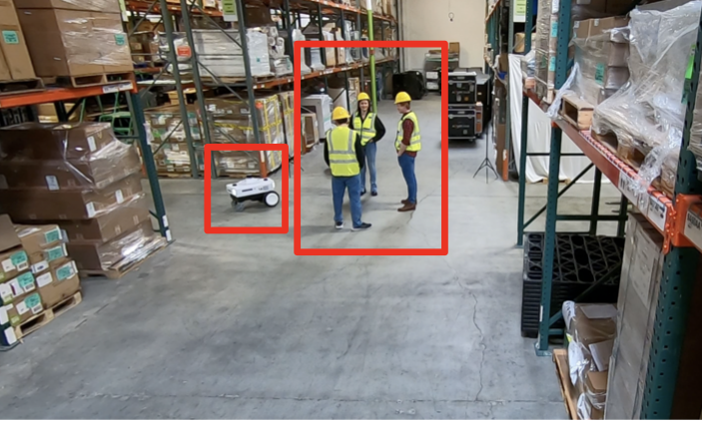
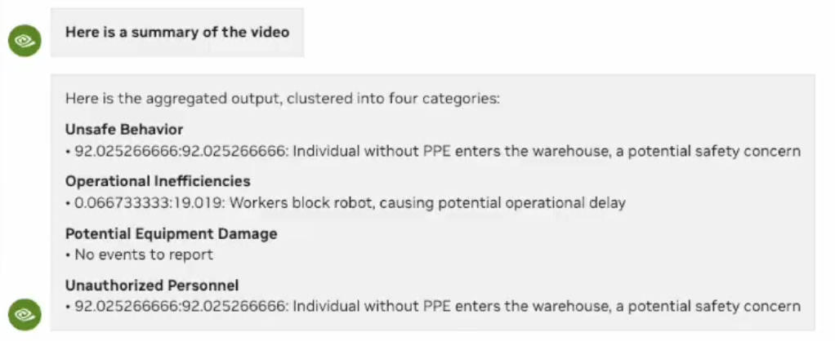
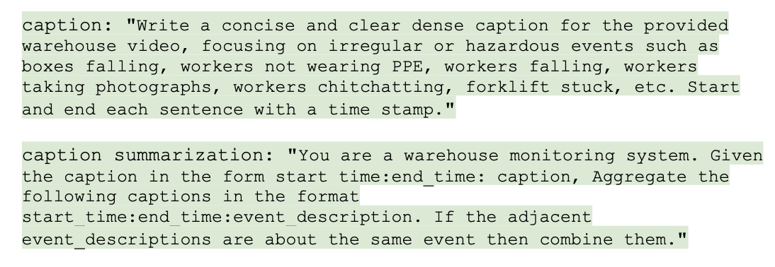


Metropolis Microservices Expands with VIA Microservice
Manages interactions between VLM, LLM, Media, and Databases
Live or Archived Video
VIA microservice
Detailed Summary Output
Guide the Agent and define a set of tasks with simple natural language Prompts
VLM NIM
LLM NIM
Helper Microservices
Saves Money & Simplifies Development of AI Agents
Simple API calls
Customizable to a range of use-cases
Upwards of 60x faster summarization than real-time
Notes:
At siggraph we are expanding Metropolis microservices. A visual AI agent builder. It’s called VIA microservices. It’s one container – but integrates and manages interactions of VLM, LLM NIMs – media and databases for you as a developer.
Through one set of API calls. It looks like a standalone microrservice. It’s like a super NIM.
It ingests live or archived video.
Like any agent – you give it a job. You provide some context. You are a warehouse monitoring system. I want you to watch out for scenario A B C. Go.
And it tears through the media blazingly fast. On order of 60x faster than realtime. And it provides richly detailed results
And because it is built to be quite a lot of agents can be built from it.

Slide 23
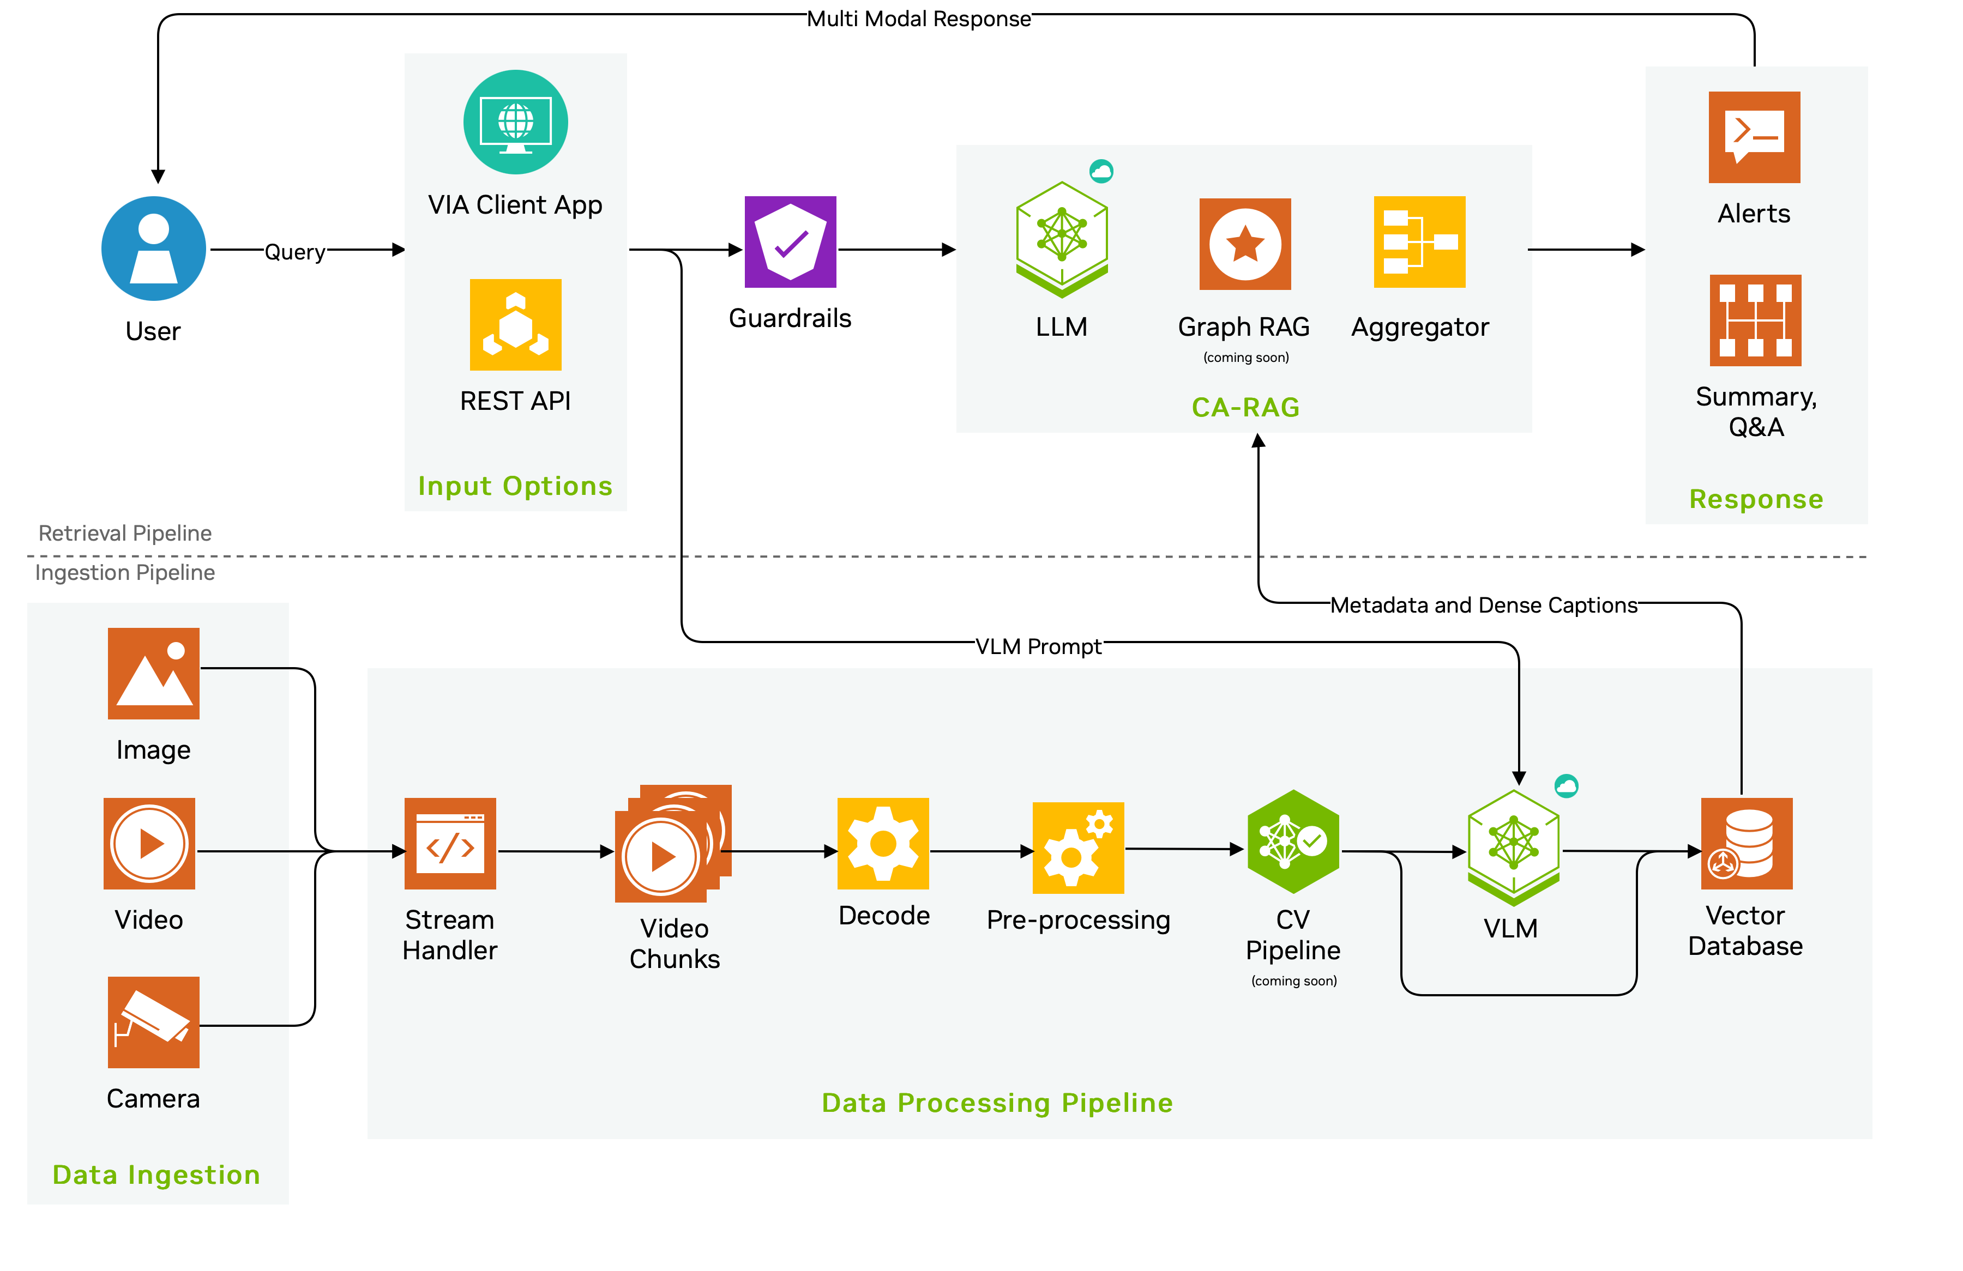
VIA Microservice Architecture
Built to handle massive videos and customizable workflows
Notes:
Let’s look at one workflow that uses both VLM and LLM NIM. A VLM generally takes in two inputs:
– A series of images which could be range anywhere from 5-100 or so.
– A prompt/query that the model should respond to taking these images into consideration.
Now, given that we have this VLM model that can understand a series of images and can answer user’s questions, we are trying to solves a bigger problem.
[With this workflow, we have taken the capability of a VLM model -- that is understanding 10s of images – and expanded it to processing a multi-hour videos ranging anywhere from 1 to 24 hr and provide a concise summary. When I say summary, I don’t mean a generic summary, but the user has complete control over what events they are interested in and how the summary should be formatted, and VIA will generate a custom summary for the ask]
RTSP: Also, not just long videos we also support real-time RTSP streams where a user can select summary duration and VIA will keep generating a live summary for that duration
The problem: Generate a summary of all the warehouse mishaps for a long videos ranging anywhere from 1-24h.
For the sake of discussion, say the VLM takes in 60 image.
Couple of things are pretty clear:
We need to map our input which is a video to the input that model expects which is a list of 60 images. If we sample only 60 images from 10 hour long video, we are bound to miss most of the small duration events like a person falling, a person entering the room, car making a wrong turn, etc. So, we need to divide our video into small parts.
And this is what we call chunking. We chunk our video into smaller parts and run VLM on each chunk. For instance, say each chunk is 5 mins.
Next, we need to combine all the generated output into one final summary.
To reiterate there are three steps:
Create Video Chunks
Call VLM on each chunk
Combine the output of the VLM to produce a summary.
This reference workflow does all the above and allows the users to tune the entire pipeline just by changing some configs.
Upload Video: The user uploads the file to the VIA which can be done either by a Web UI or by a simple CURL API call, it is first broken down into chunks (which is a configurable parameter) specifically by a component called VIA Stream Handler. Now we have the Chunks.
VLM: These chunks are then decoded and preprocessed and sent to the VLM for the inference, in parallel. So, multiple chunks are getting processed simultaneously and we are about to get the output from the VLM.
DB: As and when we get the response from the VLM, we push the response into a DB. Milvus DB to be specific.
What does the VLM output look like: Let’s say the video was about a warehouse, all the inference might contain some common description of the warehouse say there is a concrete floor, there are boxes etc depending on the query.
We want to remove this repetition from the individual summaries when we generate the final summary. And this part is done by CA-RAG.
Summarization: CA-RAG fetches all the summaries from the MilvusDB and combines them smartly only focusing on the events that user is interested in.
A great side-effect of having this two-layer inference is that it allows the following:
- Use the VLM to capture as much information you want.
Use the CA-RAG to filter and produce a summary of events you are interested in.
CA-RAG internally uses an LLM NIM (LLaMa3-70B) to perform this summarization. Again all of this is configurable. Going forward we plan to add more features such as Q&A, event detection etc to CA-RAG.

Slide 24
VIA Microservice Architecture
Built to handle massive videos and customizable workflows
Notes:
Let’s look at one workflow that uses both VLM and LLM NIM. A VLM generally takes in two inputs:
– A series of images which could be range anywhere from 5-100 or so.
– A prompt/query that the model should respond to taking these images into consideration.
Now, given that we have this VLM model that can understand a series of images and can answer user’s questions, we are trying to solves a bigger problem.
[With this workflow, we have taken the capability of a VLM model -- that is understanding 10s of images – and expanded it to processing a multi-hour videos ranging anywhere from 1 to 24 hr and provide a concise summary. When I say summary, I don’t mean a generic summary, but the user has complete control over what events they are interested in and how the summary should be formatted, and VIA will generate a custom summary for the ask]
RTSP: Also, not just long videos we also support real-time RTSP streams where a user can select summary duration and VIA will keep generating a live summary for that duration
The problem: Generate a summary of all the warehouse mishaps for a long videos ranging anywhere from 1-24h.
For the sake of discussion, say the VLM takes in 60 image.
Couple of things are pretty clear:
We need to map our input which is a video to the input that model expects which is a list of 60 images. If we sample only 60 images from 10 hour long video, we are bound to miss most of the small duration events like a person falling, a person entering the room, car making a wrong turn, etc. So, we need to divide our video into small parts.
And this is what we call chunking. We chunk our video into smaller parts and run VLM on each chunk. For instance, say each chunk is 5 mins.
Next, we need to combine all the generated output into one final summary.
To reiterate there are three steps:
Create Video Chunks
Call VLM on each chunk
Combine the output of the VLM to produce a summary.
This reference workflow does all the above and allows the users to tune the entire pipeline just by changing some configs.
Upload Video: The user uploads the file to the VIA which can be done either by a Web UI or by a simple CURL API call, it is first broken down into chunks (which is a configurable parameter) specifically by a component called VIA Stream Handler. Now we have the Chunks.
VLM: These chunks are then decoded and preprocessed and sent to the VLM for the inference, in parallel. So, multiple chunks are getting processed simultaneously and we are about to get the output from the VLM.
DB: As and when we get the response from the VLM, we push the response into a DB. Milvus DB to be specific.
What does the VLM output look like: Let’s say the video was about a warehouse, all the inference might contain some common description of the warehouse say there is a concrete floor, there are boxes etc depending on the query.
We want to remove this repetition from the individual summaries when we generate the final summary. And this part is done by CA-RAG.
Summarization: CA-RAG fetches all the summaries from the MilvusDB and combines them smartly only focusing on the events that user is interested in.
A great side-effect of having this two-layer inference is that it allows the following:
- Use the VLM to capture as much information you want.
Use the CA-RAG to filter and produce a summary of events you are interested in.
CA-RAG internally uses an LLM NIM (LLaMa3-70B) to perform this summarization. Again all of this is configurable. Going forward we plan to add more features such as Q&A, event detection etc to CA-RAG.

Slide 25
VIA Microservice Architecture
Built to handle massive videos and customizable workflows
Notes:
Let’s look at one workflow that uses both VLM and LLM NIM. A VLM generally takes in two inputs:
– A series of images which could be range anywhere from 5-100 or so.
– A prompt/query that the model should respond to taking these images into consideration.
Now, given that we have this VLM model that can understand a series of images and can answer user’s questions, we are trying to solves a bigger problem.
[With this workflow, we have taken the capability of a VLM model -- that is understanding 10s of images – and expanded it to processing a multi-hour videos ranging anywhere from 1 to 24 hr and provide a concise summary. When I say summary, I don’t mean a generic summary, but the user has complete control over what events they are interested in and how the summary should be formatted, and VIA will generate a custom summary for the ask]
RTSP: Also, not just long videos we also support real-time RTSP streams where a user can select summary duration and VIA will keep generating a live summary for that duration
The problem: Generate a summary of all the warehouse mishaps for a long videos ranging anywhere from 1-24h.
For the sake of discussion, say the VLM takes in 60 image.
Couple of things are pretty clear:
We need to map our input which is a video to the input that model expects which is a list of 60 images. If we sample only 60 images from 10 hour long video, we are bound to miss most of the small duration events like a person falling, a person entering the room, car making a wrong turn, etc. So, we need to divide our video into small parts.
And this is what we call chunking. We chunk our video into smaller parts and run VLM on each chunk. For instance, say each chunk is 5 mins.
Next, we need to combine all the generated output into one final summary.
To reiterate there are three steps:
Create Video Chunks
Call VLM on each chunk
Combine the output of the VLM to produce a summary.
This reference workflow does all the above and allows the users to tune the entire pipeline just by changing some configs.
Upload Video: The user uploads the file to the VIA which can be done either by a Web UI or by a simple CURL API call, it is first broken down into chunks (which is a configurable parameter) specifically by a component called VIA Stream Handler. Now we have the Chunks.
VLM: These chunks are then decoded and preprocessed and sent to the VLM for the inference, in parallel. So, multiple chunks are getting processed simultaneously and we are about to get the output from the VLM.
DB: As and when we get the response from the VLM, we push the response into a DB. Milvus DB to be specific.
What does the VLM output look like: Let’s say the video was about a warehouse, all the inference might contain some common description of the warehouse say there is a concrete floor, there are boxes etc depending on the query.
We want to remove this repetition from the individual summaries when we generate the final summary. And this part is done by CA-RAG.
Summarization: CA-RAG fetches all the summaries from the MilvusDB and combines them smartly only focusing on the events that user is interested in.
A great side-effect of having this two-layer inference is that it allows the following:
- Use the VLM to capture as much information you want.
Use the CA-RAG to filter and produce a summary of events you are interested in.
CA-RAG internally uses an LLM NIM (LLaMa3-70B) to perform this summarization. Again all of this is configurable. Going forward we plan to add more features such as Q&A, event detection etc to CA-RAG.

Slide 26
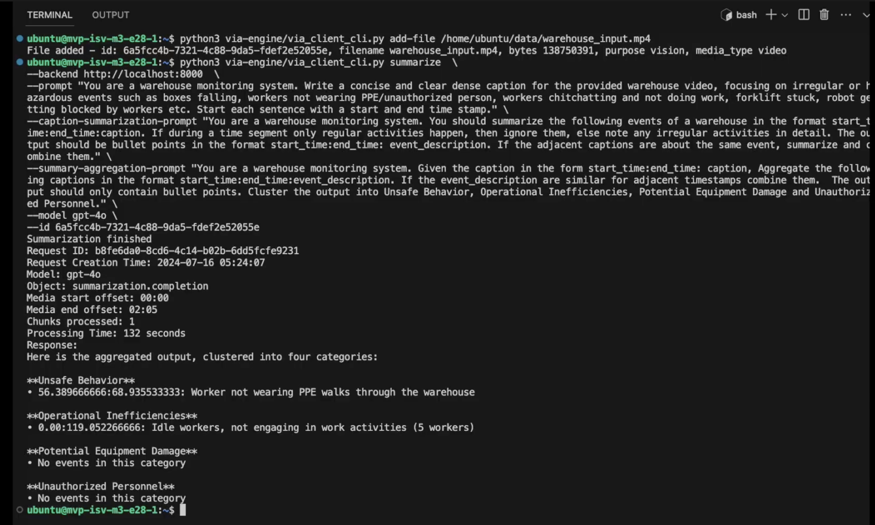
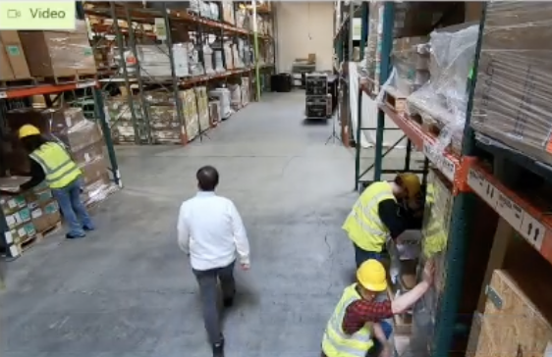
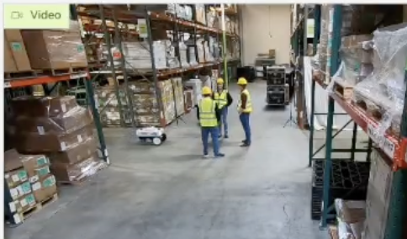
Simplify VIA Microservice with API Calls
Ingest live/archived video
Set context and assign tasks through natural language prompts
Detailed output is formatted into customizable output - with start/stop times from input video
Notes:
https://drive.google.com/file/d/17Nv_4DbAV2HhFz1bZJD6oJ25DbbDsyag/view?usp=sharing
https://nam11.safelinks.protection.outlook.com/?url=https%3A%2F%2Fdrive.google.com%2Ffile%2Fd%2F1PMEQbUPakdwq2sARy3FC0fX_vtTjA28c%2Fview%3Fusp%3Dsharing&data=05%7C02%7Cascraba%40nvidia.com%7C191149dd5fca4fcb5d8f08dca56095df%7C43083d15727340c1b7db39efd9ccc17a%7C0%7C0%7C638567081473094684%7CUnknown%7CTWFpbGZsb3d8eyJWIjoiMC4wLjAwMDAiLCJQIjoiV2luMzIiLCJBTiI6Ik1haWwiLCJXVCI6Mn0%3D%7C0%7C%7C%7C&sdata=iSRuWnJZBRnIabXC07IMGTaN8fZXu8WUy67%2BU4o2by8%3D&reserved=0
https://nam11.safelinks.protection.outlook.com/?url=https%3A%2F%2Fdrive.google.com%2Ffile%2Fd%2F1YLruNlsKcOQXWfyWDrygwwoAt_YSuDhg%2Fview%3Fusp%3Dsharing&data=05%7C02%7Cascraba%40nvidia.com%7C191149dd5fca4fcb5d8f08dca56095df%7C43083d15727340c1b7db39efd9ccc17a%7C0%7C0%7C638567081473106303%7CUnknown%7CTWFpbGZsb3d8eyJWIjoiMC4wLjAwMDAiLCJQIjoiV2luMzIiLCJBTiI6Ik1haWwiLCJXVCI6Mn0%3D%7C0%7C%7C%7C&sdata=uUpXEdSFCAk6Thu7NujjkcgJAilk6IwzKMmYZqF5rz0%3D&reserved=0

Slide 27
VIA UI Demo - Blog video 2.mp4
No Audio

Slide 28



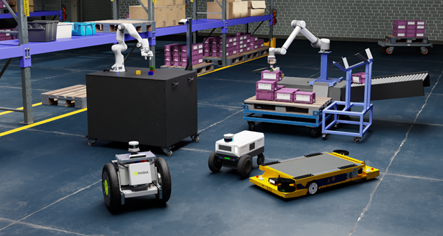
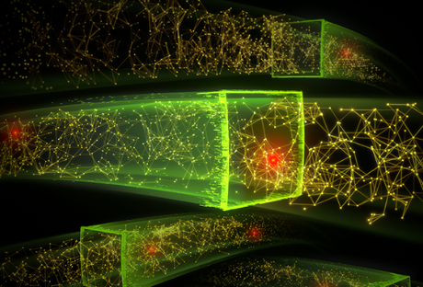
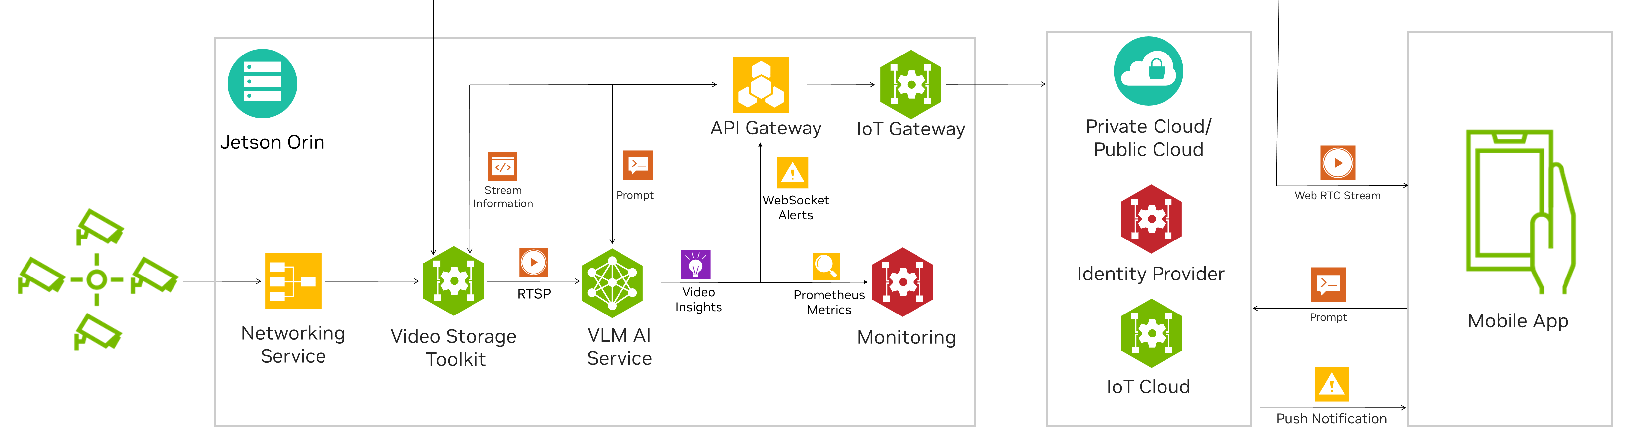


Create Customized Workflows with VIA Microservice
RIVA ASR
TTS
• • •
ISSAC SIM
MORPHEUS
VIA MICROSERVICE
Knowledge Base
(RAG)
Custom DL Models
INTEGRATE NVIDIA/3P CUSTOM SERVICES
CREATE YOUR CUSTOM WORKFLOW
Cloud | Data Center| Workstations | Edge
INTEGRATE INTO YOUR WORKFLOW
INTEGRATE INTO YOUR WORKFLOW
INTEGRATE INTO YOUR WORKFLOW

Slide 29


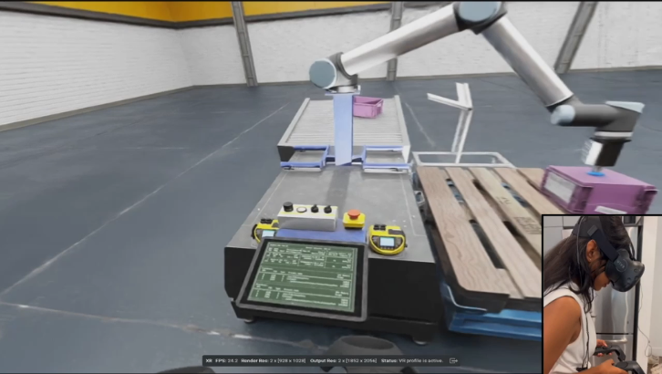


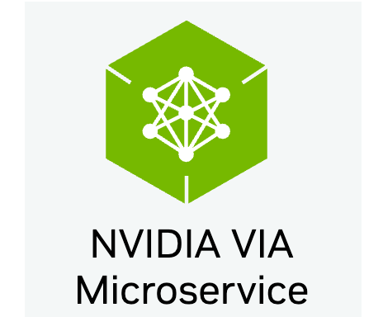
Custom Workflow: Interact with Virtual Environments
Architecture
Stream
Query
RIVA ASR
Knowledge Base
RIVA TTS
Question: Can you explain what’s going on here?
Response: Nice to meet you! I am VirtuVision, your assistive agent for designing industrial robot simulations through VR. Based on the provided images, I observe that we have a Universal Robots UR10 collaborative robot arm, also known as a Cobot.
Audio Response

Slide 30
VirtuVision-IsaacSIM.mp4
With Audio

Slide 31
Visual AI Agents on NVIDIA Jetson

Slide 32
Cloud-Native Vision AI Workflows for the Edge
Build Visual AI Agent on NVIDIA Jetson

Slide 33
Video 2.mp4
No Audio

Slide 34
Next Steps

Slide 35
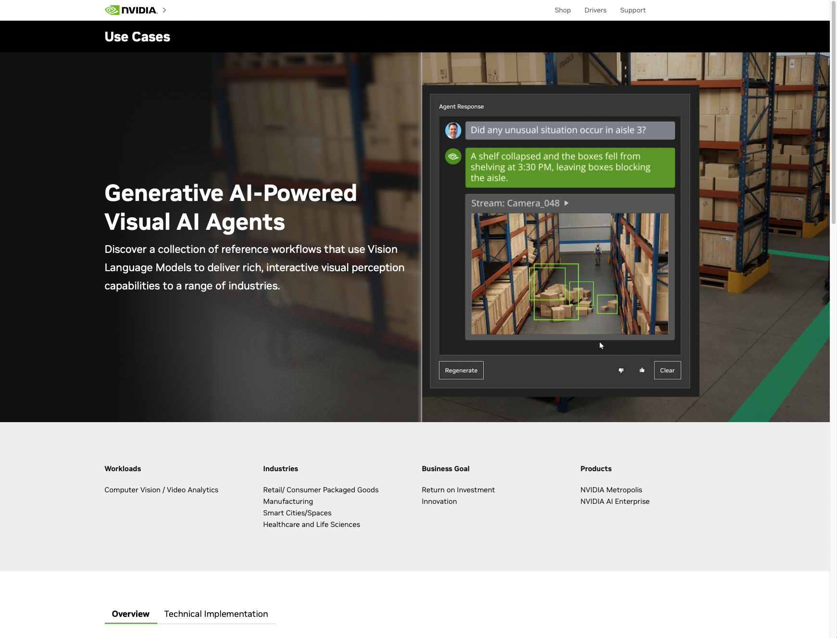
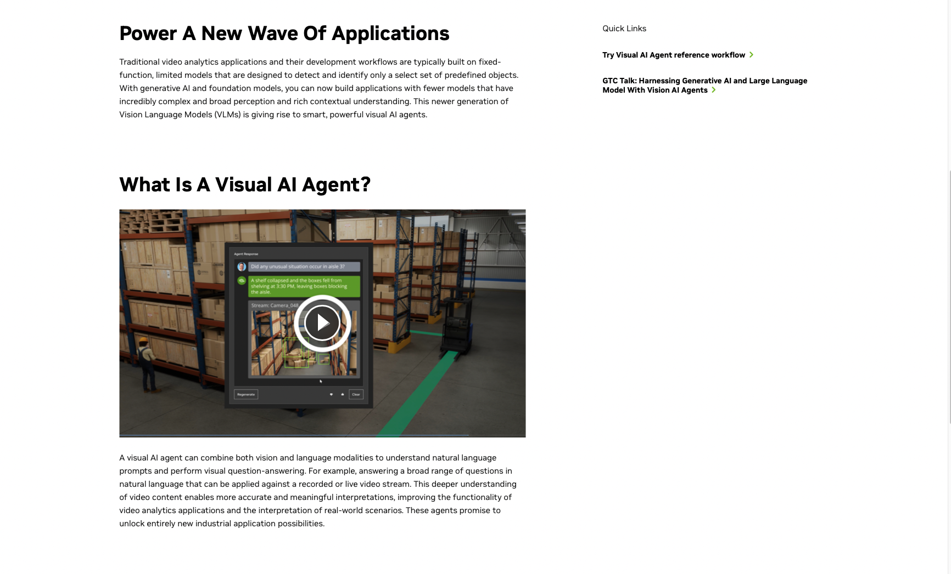
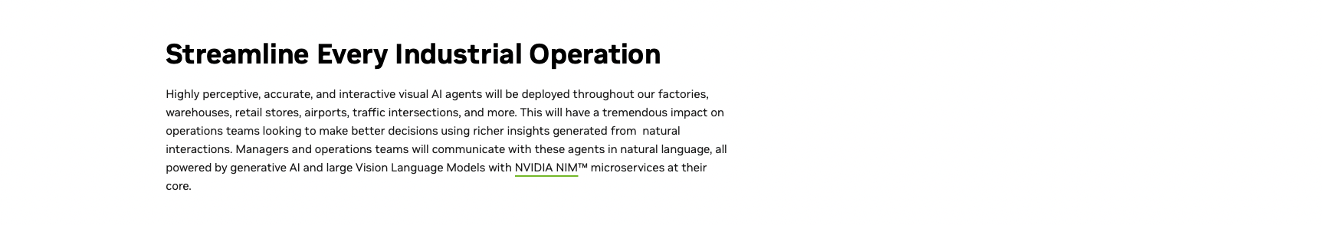
Get Started Building Visual AI Agents
https://www.nvidia.com/en-us/use-cases/visual-ai-agents/
One NVIDIA page to help connect you with developer tools and helpful content
Links to 5 sample / reference apps to get experimenting with VLMs and customizing visual agents in minutes
Links to NVIDIA NIM GitHub repos
Links to blogs & upcoming webinars
Videos showing a wide range of visual AI agents use-cases

Slide 36
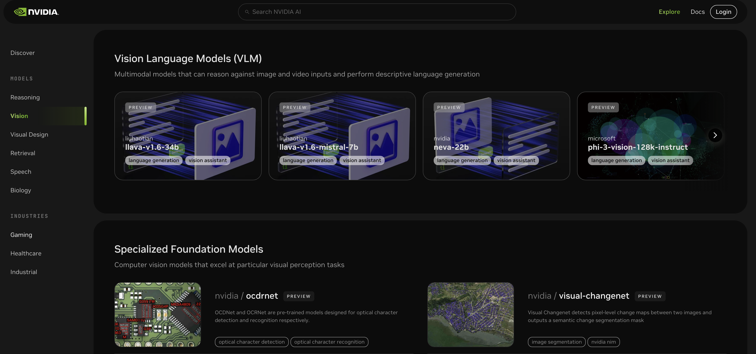

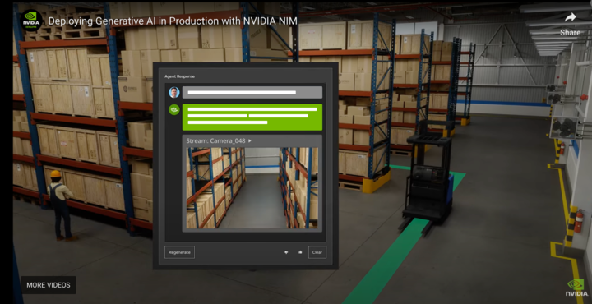
Resources
Metropolis Web Pages
Reference Apps
Visual AI Agent Web Page
VLM NIM on build.nvidia.com
Try Visual AI Agent with NIM
Download VIA Microservice
Build Visual AI Agent on Jetson
Developer Blogs / Docs
Videos
Build Gen AI agent for the edge
VLM-powered AI Agents Using VIA Microservices and NIM
NIM based visual AI agent
VIA microservice montage
Video agent at the edge

